Slide 1

IOT ENABLED SCHOOL BUS TRACKING AND STUDENT MONITORING SYSTEM
ANAND INSTITUTE OF HIGHER TECHNOLOGY (An Autonomous Institution ) DEPARTMENT OF COMPUTER SCIENCE AND ENGINEERING
TEAM MEMBERS
GAYATHRI B (310121104031)
INDUJA S (310121104040)
GUIDE
Dr.S.Jancy Sickory Daisy,M.Tech.,Ph.D
Associate Professor

Slide 2
AGENDA
Domain Introduction
Existing System
Problem Statement
Objectives
Scope
Proposed System
Architecture
Modules and Explanation
Output Screenshots
Conclusion
References

Slide 3
DOMAIN INRODUCTION
IoT enables communication between physical devices via the internet.
Connects bus-tracking hardware to the cloud, allowing parents and school authorities to monitor bus location in real-time.
Embedded Systems utilize microcontrollers (e.g., NodeMCU, ESP8266) and RFID scanning for automated attendance.
This project aims to enhance student safety and optimize school bus operations.
.

Slide 4
EXISTING SYSTEM
Manual Attendance: The bus driver or assistant manually records student attendance, which is prone to human errors.
Lack of Student Entry & Exit Monitoring: There is no system to track when a student boards or exits the bus. In case of a missing student, identifying and responding to the issue takes longer.
Inefficient Communication: Communication between parents, school authorities, and drivers is unorganized. Parents often receive delayed updates about emergencies.
Slow Emergency Handling: There is no automatic alert system in case of an accident or emergency. The school and parents rely on manual calls, causing delays in response.

Slide 5
PROBLEM STATEMENT
Student Safety Hazard: Potential risk if a student goes missing or an emergency occurs without immediate detection or response.
Manual and Reactive Systems: Current methods depend on manual attendance and delayed communication, causing inaccuracies and slow responses.
Lack of Automated Alerts: In emergencies like Bus Breakdown, there are no instant notifications to ensure rapid action.
Communication Gaps: Delays in sharing bus updates lead to parental anxiety and inefficient coordination among drivers, parents, and school staff.
.

Slide 6
OBJECTIVES
To provide real-time alerts notification via Telegram for both parents and Management.
To automatically trigger emergency protocols for swift response.
To track student entry and exit using RFID scanning and centralized data.
To proactively ensure student safety by reducing risks and improving communication.

Slide 7
SCOPE
Triggers immediate alerts through push notifications about emergencies.
Automates attendance with RFID code scanning to ensure accurate student monitoring.
Delivers a cost-effective, user-friendly system that simplifies adoption for schools and parents.
Enhances Safety by minimizing risks of missing students and enabling rapid emergency response.

Slide 8
PROPOSED SYSTEM AND ITS SOLUTION
Automated Student Attendance & Monitoring: Uses RFID code scanning and a NodeMCU (ESP8266/ESP32) to detect student entry and exit, automatically updating attendance records in a centralized system.
Real-Time Oversight: Parents and school authorities can track the student status through a mobile app, receiving continuous updates and data analytics.
Instant Alerts: By using Telegram sending a real-time alerts for emergencies, delays, or route deviations, keeping stakeholders informed at all times.

Slide 9
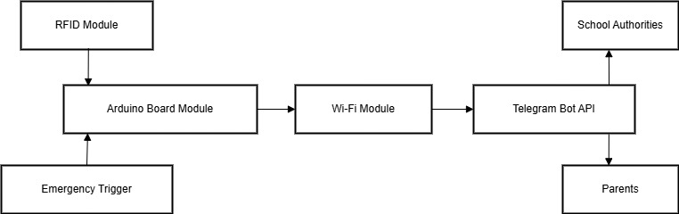
ARCHITECTURE

Slide 10
MODULES
RFID Module: Reads unique identification data from RFID tags to verify user identity. It acts as the primary input for access or emergency activation.
Arduino Board Module: Serves as the main controller that processes inputs from sensors and modules. Executes commands and manages communication between components.
Wi-Fi Module: Enables wireless internet connectivity for real-time data transfer. It links the Arduino to online services like Telegram.
Telegram Bot API: Allows the system to send and receive messages through Telegram. Used to notify users or authorities instantly in emergencies.
Emergency Trigger: A safety mechanism activated via RFID or button to alert in critical situations. Sends real-time emergency messages through Telegram.

Slide 11
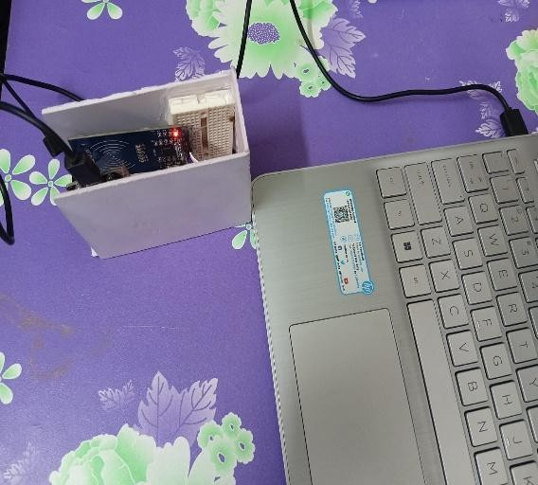
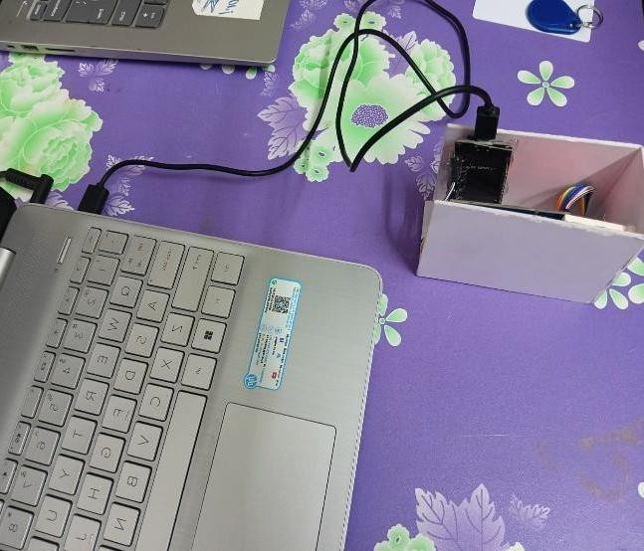
OUTPUT SCREENSHOTS
USB PORT IS CONNECTED WITH ESP32 NODEMCU AND RFID SCANNER TO SCAN THE ACCESS CARD TO SEND DATA FROM SENSOR TO CLOUD.

Slide 12

RFID SCANNER ACCESS CARD FOR STUDENT 1 AND STUDENT 2 TO DETECT WHEN THEY GET ENTRY OR EXIT THE BUS.

Slide 13
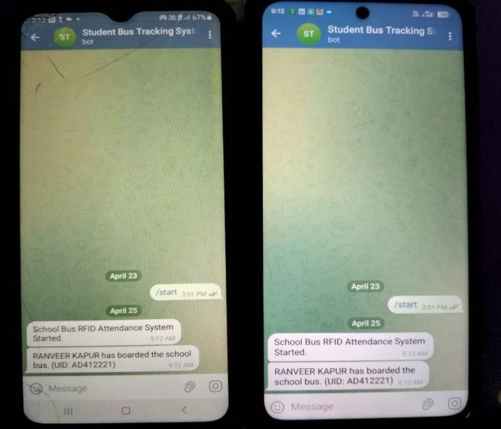
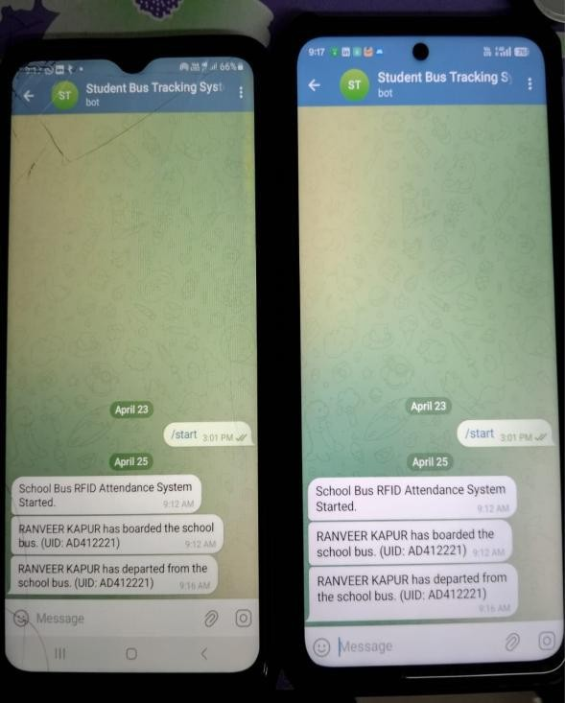
THIS IS A TELEGRAM BOT DESIGNED FOR PARENTS AND SCHOOL MANAGEMENT TO RECEIVE NOTIFICATIONS WHEN A STUDENT 1 (RANVEER KAPUR) BOARDS OR DEPARTS.

Slide 14
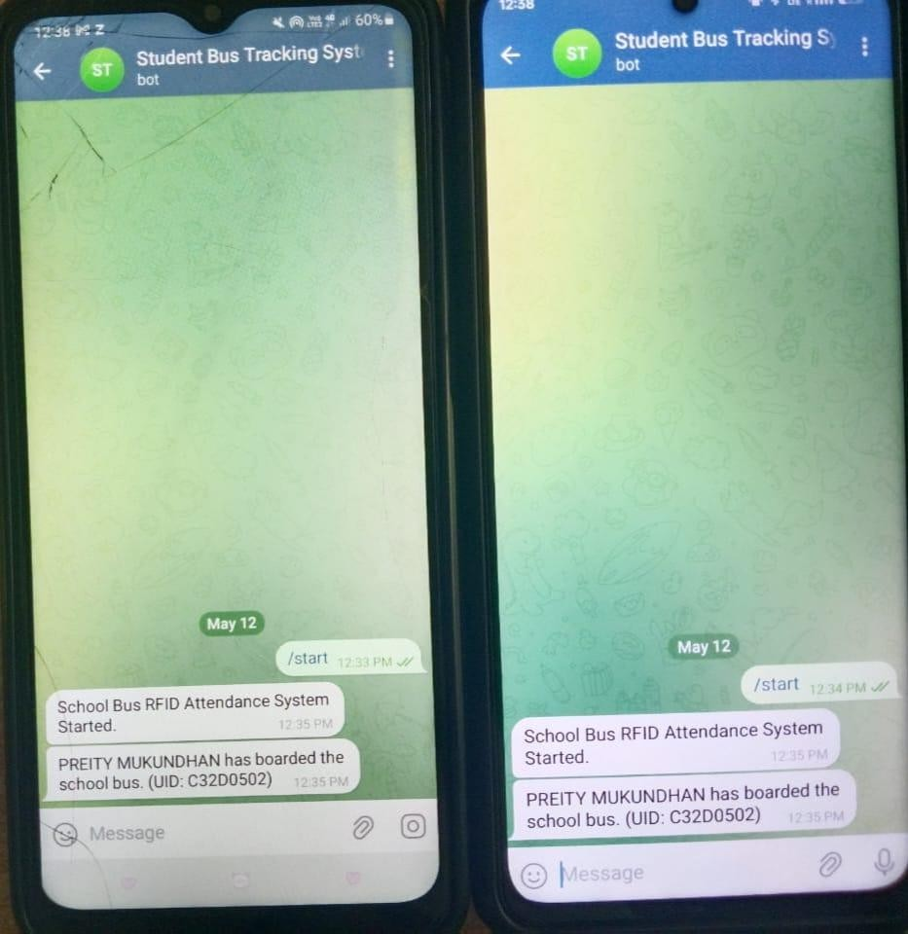
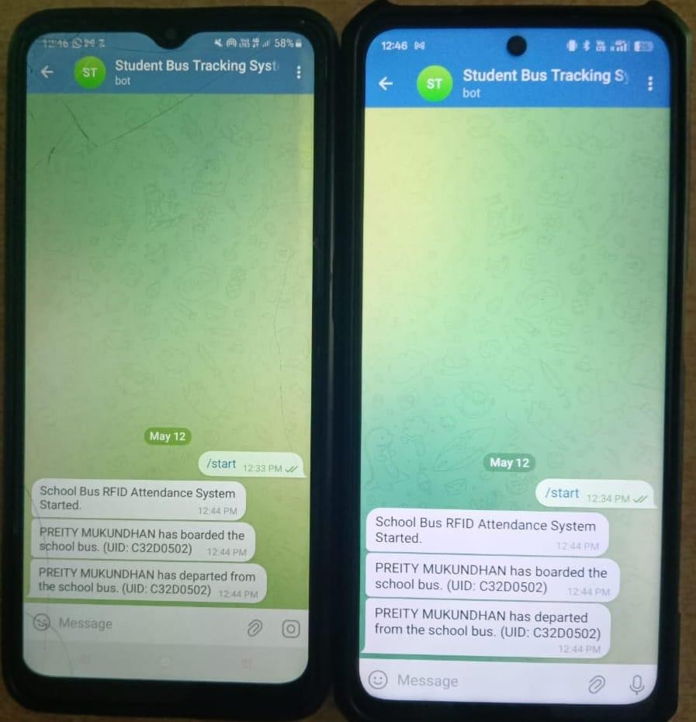
STUDENT 2(PREITY MUKUNDHAN)

Slide 15
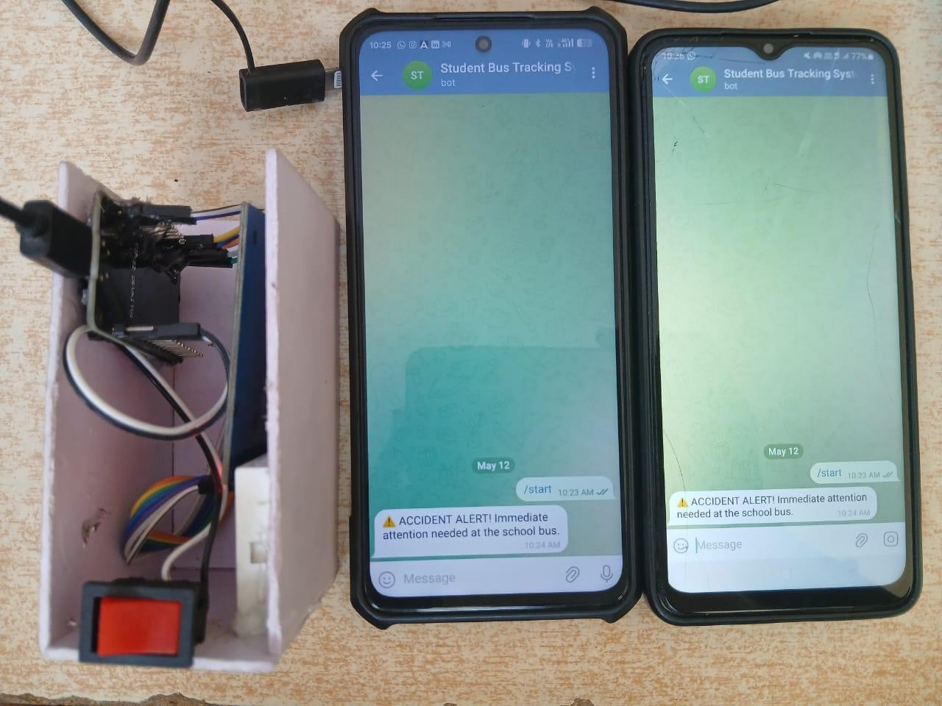
EMERGENCY ALERT MESSAGE

Slide 16
CONCLUSION
Our RFID-based student bus tracking system using NodeMCU ensures secure student authentication, real-time location tracking, and timely notifications. It enhances student safety, automates attendance, and improves communication with parents and school authorities. This smart solution promotes efficiency and supports the digital transformation of school transport systems.

Slide 17
REFRENCES
[1] Noureldin, A. Osman, and N. El-Sheimy, ‘‘A neuro-wavelet method for multi- sensor system integration for vehicular navigation,’’ Meas. Sci. Technol., vol. 15, no. 2, pp. 404–412, Feb. 2004.
[2] M. R. Islam and J.-M. Kim, ‘‘An effective approach to improving low-cost GPS positioning accuracy in real-time navigation,’’ Sci. World J., vol. 2014, pp. 1–8, Jan. 2014.
[3] J.-Y. Huang and C.-H. Tsai, ‘‘Improve GPS positioning accuracy with context awareness,’’ in Proc. 1st IEEE Int. Conf. Ubi-Media Comput., Jul. 2008, pp. 94–99. [Online]. Available: https://ieeexplore. ieee.org/document/4570872.
[4] Bhatt, P. Aggarwal, V. Devabhaktuni, and P. Bhattacharya, ‘‘A new source difference artificial neural network for enhanced positioning accuracy,’’ Meas. Sci. Technol., vol. 23, no. 10, Oct. 2012, Art. no. 105101.
[5] Li, N. Song, G. Yang, M. Li, and Q. Cai, ‘‘Improving positioning accuracy of vehicular navigation system during GPS outages utilizing ensemble learning algorithm,’’ Inf. Fusion, vol. 35, pp. 1–10, May 2017

Slide 18
THANK YOU

